Slide 1
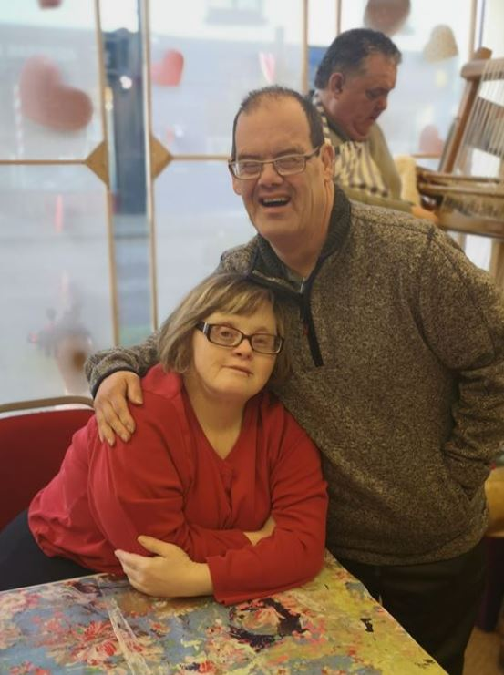

3 Year Plan
2020-2023

Slide 2
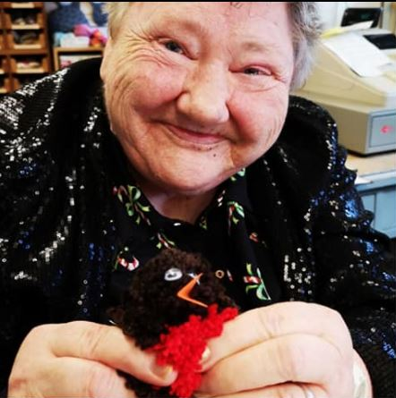
Welcome
Welcome to the new ECHO 3 year plan.
The plan shows how ECHO wants to develop over the next few years and provides guidance to make sure we are going in the direction that we want to.
A plan is only useful if it is used. We will make sure everyone in ECHO knows about the plan and how what they do fits into it.

Slide 3
ECHO in the next 3 years
Prepare
Develop
Strengthen
Over the life of the last 3 year plan ECHO grew and almost doubled in size.
ECHO is still adjusting to this growth and so the trustees have decided that for this plan the aim is to strengthen the organisation and improve how we do things.
This way we will be better prepared to develop in the future.
This does not mean that ECHO won’t develop as we will continue to carefully look at any opportunities that arise.

Slide 4
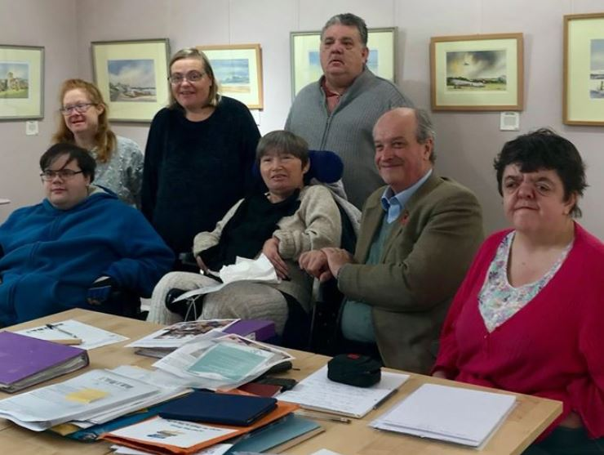
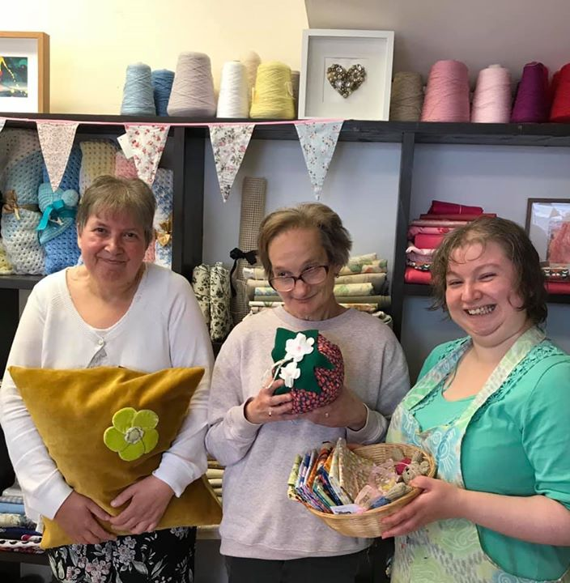
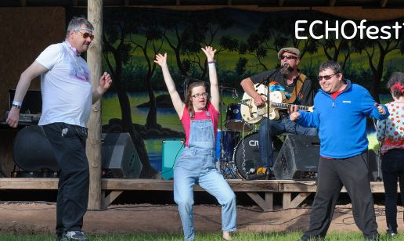
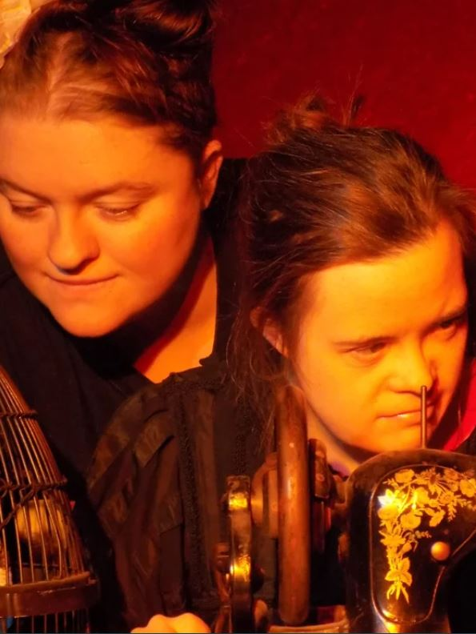
ECHO’s Values
In all our work, ECHO believes that people need:
To be recognised and treated as individuals
To be valued in their local community
To have friendships and relationships
To have meaningful choices which enhance quality of life
To have expectations of achievement
To have the opportunity to be heard on issues that affect their lives
To have support from good quality trained staff
To take an active part in planning and decisions that affect their lives

Slide 5
How the Plan works
It’s like a stair case.
You need each of the steps to get to where you want to be.
You can’t miss any steps out or it won’t work
From the Bottom you can see where you want to get to
From the Top you can see what you need to do to get to your destination
Vision
How we want the world to be
Mission
Mission
Mission
What we will do to help shape the world we want to see
AIMS
AIMS
AIMS
What we want to achieve
Objectives
Objectives
Objectives
How we are going to do it!
Outcomes
What change we want to see

Slide 6
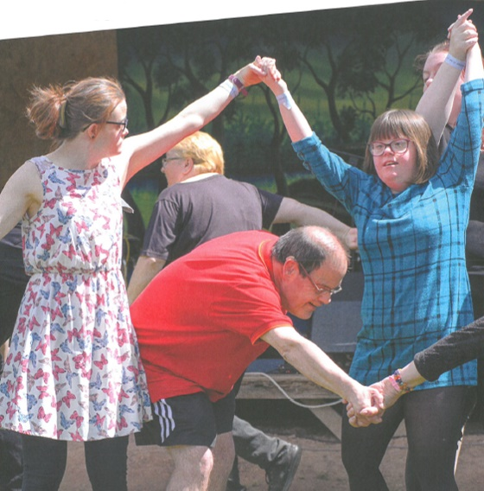
ECHO’s Vision
‘A society where all people with disabilities are heard, valued, respected and supported to make choices and flourish.’
ECHO’s Mission
‘We want to make a positive difference to the lives of people with disabilities in Herefordshire, supporting them to both feel and be valued members of the community.’

Slide 7
Choice
Support
Community
Involvement
Quality
Collaboration
6 Aims of ECHO
ECHO has six aims that we want to see reflected in all the work that we do.
These are the things that are important to us and our participants.

Slide 8
Choice
Support
Community
Involvement
Quality
Collaboration
CHOICE
To support our participants to be happy & healthy with a variety of stimulating choices

Slide 9
Choice
Support
Community
Involvement
Quality
Collaboration
SUPPORT
To give the right support and encouragement to build confidence and teach skills that enrich our participants’ lives

Slide 10
Choice
Support
Community
Involvement
Quality
Collaboration
COMMUNITY
To support people to have a good social life, to help them keep in touch with friends and get involved in the community

Slide 11
Choice
Support
Community
Involvement
Quality
Collaboration
INVOLVEMENT
To give the time, respect and support needed for our participants to be involved in the planning, decision making and the running of ECHO

Slide 12
Choice
Support
Community
Involvement
Quality
Collaboration
QUALITY
To provide high quality services that are integrated, visible and have value to the community

Slide 13
Choice
Support
Community
Involvement
Quality
Collaboration
COLLABORATION
To build connections with other organisations and support our participants to join their activities, giving them more opportunities.

Slide 14
Vision
A society where all people with disabilities are heard, valued, respected and supported to make choices and flourish.
Mission
We want to make a positive difference to the lives of people with disabilities in Herefordshire, supporting them to both feel and be valued members of the community.
AIMS
CHOICE
To support our participants to be happy & healthy with a variety of stimulating choices
SUPPORT
To give the right support and encouragement to build confidence and teach skills that enrich our participants’ lives
COMMUNITY
To support people to have a good social life, to help them keep in touch with friends and get involved in the community
INVOLVEMENT To give the time, respect and support needed for our participants to be involved in the planning, decision making and the running of ECHO
QUALITY
To provide high quality services that are integrated, visible and have value to the community
COLLABORATION
To build connections with other organisations and support our participants to join their activities, giving them more opportunities.

Slide 15
AIMS
CHOICE
To support our participants to be happy & healthy with a variety of stimulating choices
SUPPORT
To give the right support and encouragement to build confidence and teach skills that enrich our participants’ lives
COMMUNITY
To support people to have a good social life, to help them keep in touch with friends and get involved in the community
INVOLVEMENT To give the time, respect and support needed for our participants to be involved in the planning, decision making and the running of ECHO
QUALITY
To provide high quality services that are integrated, visible and have value to the community
COLLABORATION
To build connections with other organisations and support our participants to join their activities, giving them more opportunities.
OBJECTIVES
Promote health & mental wellbeing through choices made
Provide stimulating activities that challenge existing abilities and build on them
Use a Person Centred approach to address individual needs, wishes and choice
Ensure Staff and volunteers have the right skills and enthusiasm
Improve and develop communication and understanding skills (total communication)
Citizenship – support participants to be part of local, regional and national consultations, elections etc.
Increased engagement with family carers
Encourage volunteers to take ownership of planning and delivery of own activities according to their skills
Develop a range of Community focussed activities
Provide up to date information about activities and events
All projects to have a community aspect
Develop the skills and confidence of participants to express their views
Improve communication within ECHO
Identify potential barriers to participation and take active steps to address them
Provide opportunities for people to be involved in planning, review and decision making in ECHO
Continue to provide high quality opportunities
Look for opportunities and develop ECHO’s business
Contribute towards Trusted Charity Mark
Manage ECHO’s money effectively to deliver high quality services
To support income generation for ECHO and it’s projects
All projects to consider how they collaborate with other organisations and projects
Increase volunteering opportunities inside and outside ECHO

Slide 16
OBJECTIVES
Promote health & mental wellbeing through choices made
Provide stimulating activities that challenge existing abilities and build on them
Use a Person Centred approach to address individual needs, wishes and choice
Ensure Staff and volunteers have the right skills and enthusiasm
Improve and develop communication and understanding skills (total communication)
Citizenship – support participants to be part of local, regional and national consultations, elections etc.
Increased engagement with family carers
Encourage volunteers to take ownership of planning and delivery of own activities according to their skills
Develop a range of Community focussed activities
Provide up to date information about activities and events
All projects to have a community aspect
Develop the skills and confidence of participants to express their views
Improve communication within ECHO
Identify potential barriers to participation and take active steps to address them
Provide opportunities for people to be involved in planning, review and decision making in ECHO
Continue to provide high quality opportunities
Look for opportunities and develop ECHO’s business
Contribute towards Trusted Charity Mark
Manage ECHO’s money effectively to deliver high quality services
To support income generation for ECHO and it’s projects
All projects to consider how they collaborate with other organisations and projects
Increase volunteering opportunities inside and outside ECHO
OUTCOMES
Improve Physical and mental Health
Increase in number and types of activity
Increased attendance at Echo Projects
Increase in number of personal objectives achieved
Decrease in behaviour related incidents
Increased skills for participants
Increased confidence
All Staff & volunteers trained in key skills
New training requirements identified and funded
Increased awareness and involvement in local, regional and national issues
Increased engagement in the community
Improved information about transport and independent travel
Increased awareness of Rep Group and their role
No. of rep visits to projects
People feel more valued
People feel ownership of projects
Volunteers recruited and retained
Achieve level 2 of Trusted Charity Mark
Greater confidence in the public perception of ECHO and people with LD their skills and abilities
Increased revenue
Increase in organisations engage in ECHO activities
Projects are full
More opportunities
People feel more valued

Slide 17
Outcomes
Improve Physical and mental Health
Increase in number and types of activity
Increased attendance at Echo Projects
Increase in number of personal objectives achieved
Decrease in behaviour related incidents
Increased skills for participants
Increased confidence
All Staff & volunteers trained in key skills
New training requirements identified and funded
Increased awareness and involvement in local, regional and national issues
Increased engagement in the community
Improved information about transport and independent travel
Increased awareness of Rep Group and their role
No. of rep visits to projects
People feel more valued
People feel ownership of projects
Volunteers recruited and retained
Achieve level 2 of Trusted Charity Mark
Greater confidence in the public perception of ECHO and people with LD their skills and abilities
Increased revenue
Increase in organisations engage in ECHO activities
Projects are full
More opportunities
People feel more valued
Measured By
Lamplight surveys
Reviews and supporting evidence
Case Studies
Quotes
Photo/video
Staff skills audit
Lamplight surveys
Reviews and supporting evidence
Case Studies
Quotes
Photo/video
Rep Group membership
Board membership
Case Studies
Quotes
Photo/video
Achievement of TCM
Survey of external perception
Increased revenue
VOIDS
User satisfaction surveys
Case Studies
Quotes
Photo/video
Project surveys (no. of community projects)
No. of sports clubs offering accessible sessions
Number of opportunities
Lamplight surveys
Case Studies
Quotes
Photo/video
Example Measures
Lamplight surveys
Reviews and supporting evidence
Case Studies
Quotes
Photo/video
Staff skills audit
Lamplight surveys
Reviews and supporting evidence
Case Studies
Quotes
Photo/video
Case Studies
Quotes
Photo/video
Rep Group membership
Board membership
Case Studies
Quotes
Photo/video
No. of Rep Group/Trustee visits to Projects
Case Studies
Quotes
Photo/video

Slide 18
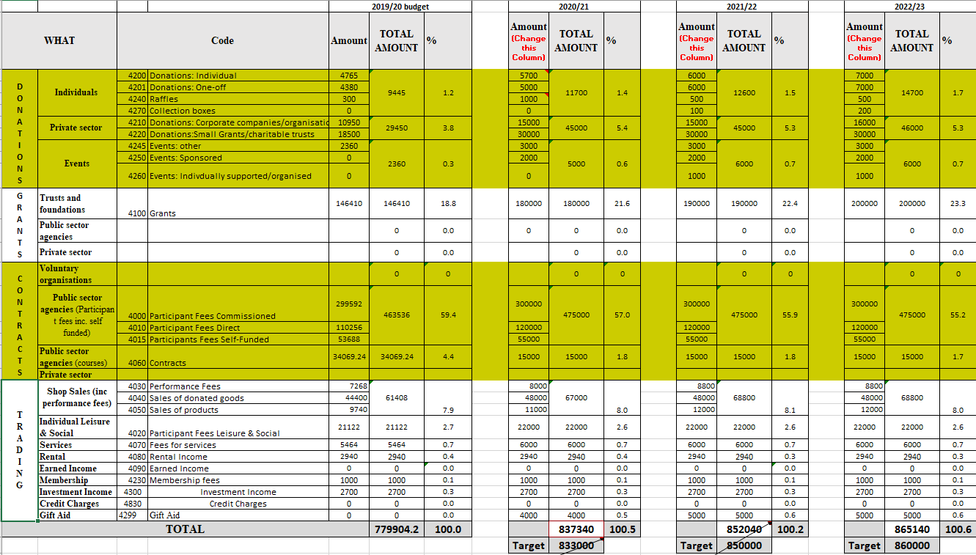
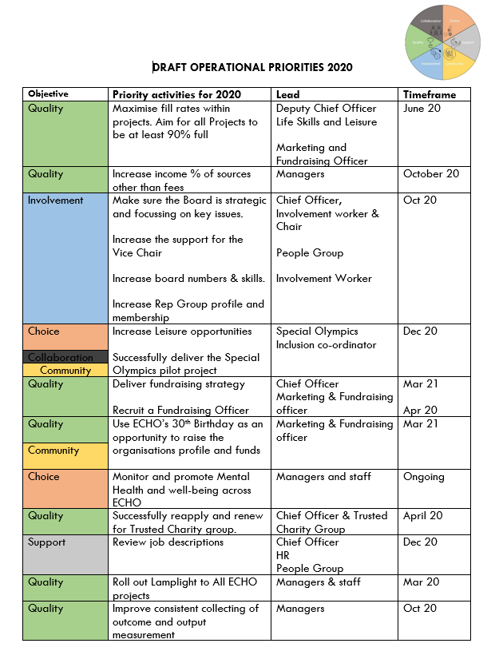
LINKS WITH OTHER PLANS
This document is supported by
Budget
Marketing Plan
Fundraising Plan
Operational Priorities

Slide 19
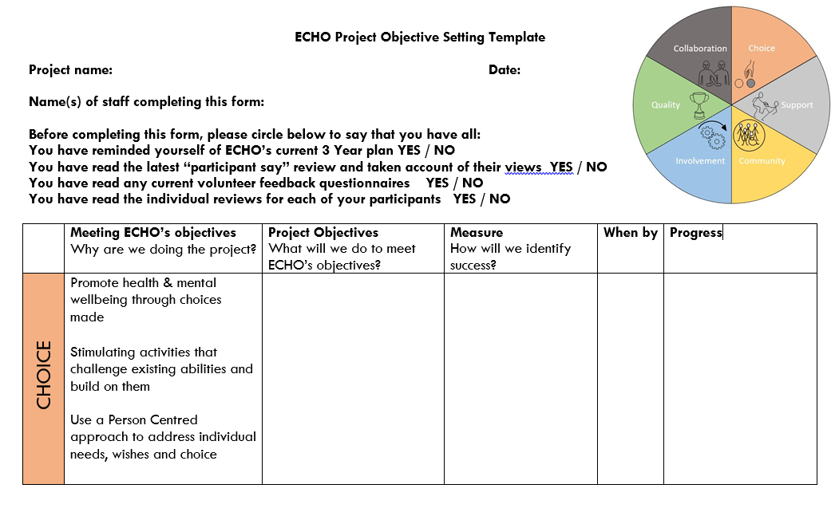
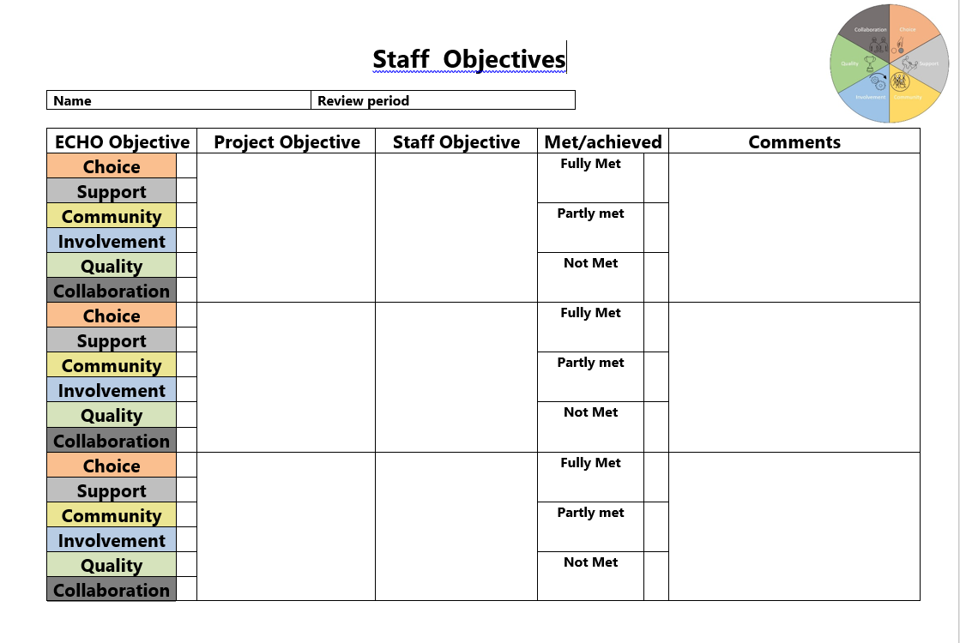
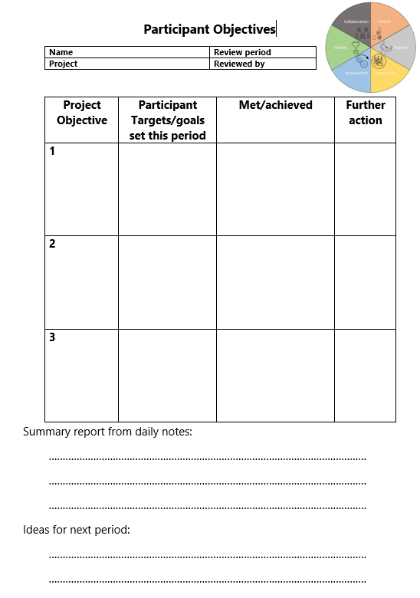
A Living Plan
To Keep the plan alive we will use it to help set annual priorities and targets for:
ECHO as a whole
Projects
Staff
Participants
We will also ensure that the plan is displayed at our sites and encourage a focus on different aspects throughout the year

